Slide 1
Group projects in SE courses from a student’s viewpoint
Andreja Smetko
Mentor: prof.dr.sc. Krešimir Fertalj
University of Zagreb
Faculty of Electrical Engineering and Computing

Slide 2
Overview
Projects students were involved in
Levels of flexibility in projects
Positive sides of projects
Negative sides of projects
Proposal for improvement

Slide 3
Projects students are involved in
“Case study” projects as the main focus point
A total of four obligatory projects (may ammount to 8 with elective courses)

Slide 4
Goal to be achieved using projects in class
Some courses use projects only to help students view the subject from a practical point of view (e.g. Software Design, Programming Language Translation)
There is a special course which is solely focused on carrying out a project and experiencing all of its stages (e.g. Software Desing Project)

Slide 5
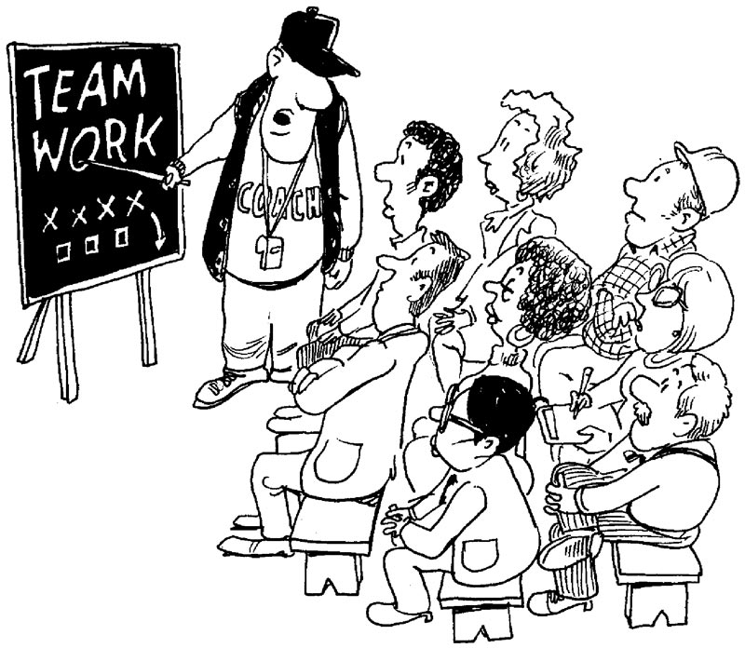
Choosing your teammates
Some students were selected as team leaders and the others could choose their team leaders (and vice versa)
Students were distributed into groups beforehand based on previous grades, gender, etc. to achieve a balanced team

Slide 6
Socially realistic projects vs. “imaginary “ projects
Socially realistic projects were given as tasks where students had to experience software engineering in practice
Imaginary tasks (such as building a compiler) were given in CS classes
Some classes gave unique task to every group, whereas some gave all the groups the same task

Slide 7
The bright side of project tasks
The point of using projects in class has been made very clear and students have responded positively and enthusiastically
Giving practical experience that would have not otherwise been given
Social inclusion via “mixed” groups

Slide 8
Challenges of teamwork – technical and time management
It was often the case that students were not technically prepared for the tasks given to them
Spending a fair amount of time “filling the gaps” in students’ technical knowledge instead of getting to the point of the project
Students had to plan their actions without knowing how time-consuming they are

Slide 9
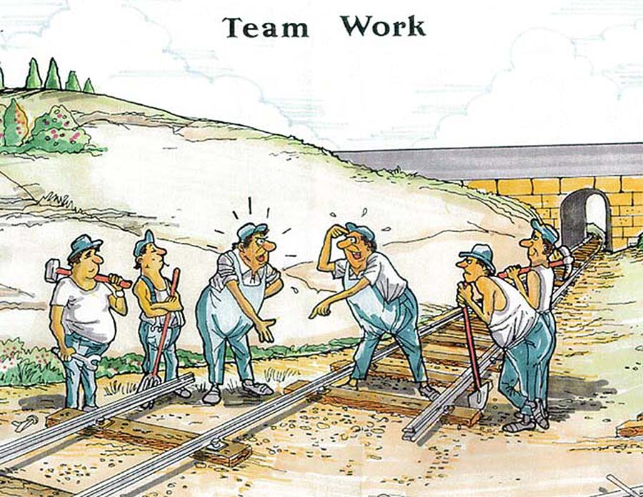
Challenges of teamwork – people management
Students set as team leaders have not had proper education on team management and were thus unable to lead the team properly
Lack of facilities often led to arguments and time-loss

Slide 10
Challenges of teamwork – grading students’ work
An often case of one or two overworked students in a team
Some courses only grade the final outcome of the team – not students individually
It is very hard to objectively grade every person’s contribution – even the courses which tried to do so also graded the final result
Students who bear the bigger burden feel frustrated and are not properly awarded for their work

Slide 11
Improvement suggestions
Make sure that the students are only required to do what is taught in the course and the course(s) that precede it
Provide additional training for team leaders (especially regarding the time and team management)
Provide facilities for meetings and other teamwork

Slide 12
Questions?
Thank you for your time ☺

